Slide 1

RWI Rhymes Letter Formation
Just click on the pencil and it will show you how to form the letter that you have chosen.
Press the ‘menu’ button to return back to the letter choices.

Slide 2
Alphabet Lower Case
Click on the letter that you would like to practice.
a
b
c
d
e
f
g
h
i
j
k
l
m
n
o
p
q
r
s
t
u
v
w
x
y
z
Back to Choices

Slide 3
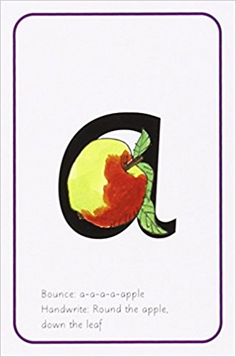
Click the pencil, watch and copy
Bounce a-a-a-apple: Around the apple and down the leaf.
a
Menu

Slide 4
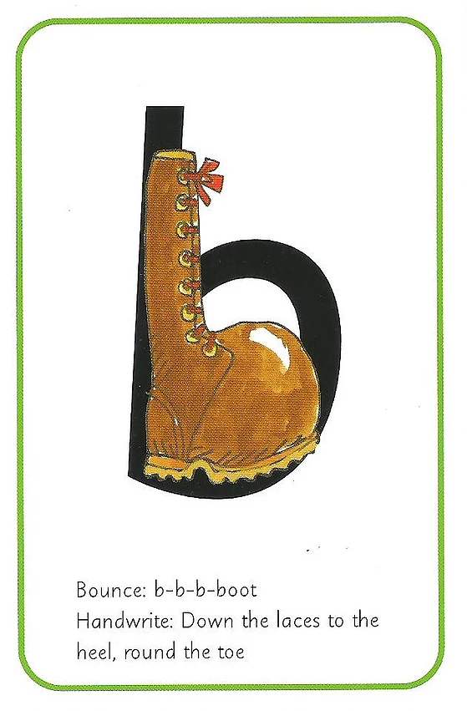
Click the pencil, watch and copy
Bounce b-b-b-boot: down the laces to the heel, round the toe.
b
Menu

Slide 5
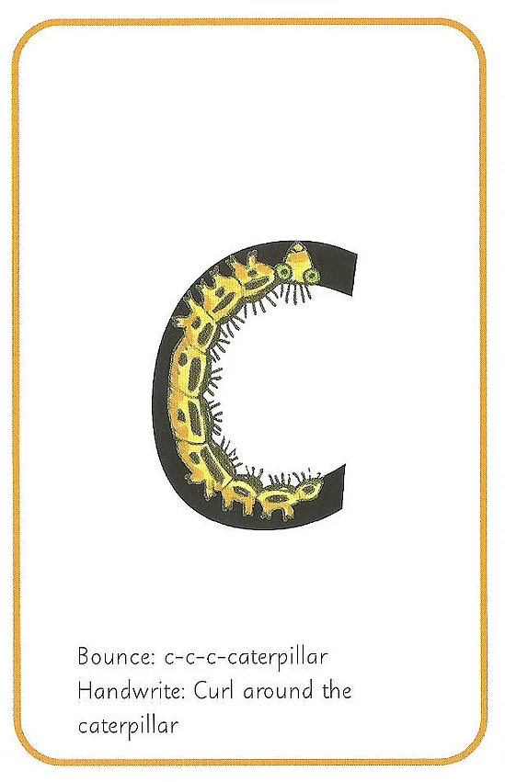
Click the pencil, watch and copy
Bounce c-c-c-caterpillar: Curl around the caterpillar.
c
Menu

Slide 6

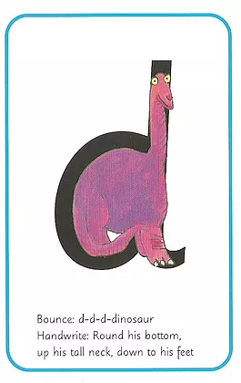
Click the pencil, watch and copy
Bounce d-d-d-dinosaur: Round his bottom, up his tall neck and down to his feet.
d
Menu

Slide 7
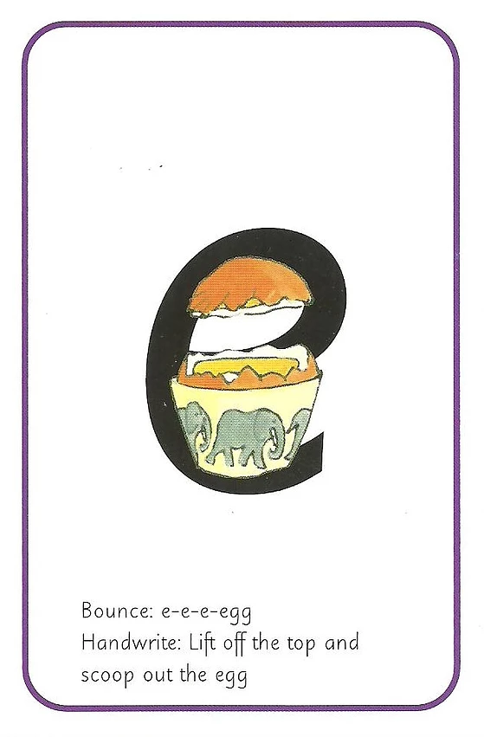
Click the pencil, watch and copy
Bounce e-e-e-egg: Lift off the top and scoop out the egg.
e
Menu

Slide 8
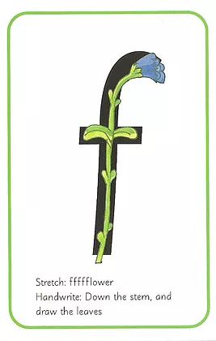
Click the pencil, watch and copy
Stretch ffffflower: Down the stem and draw the leaves.
f
Menu

Slide 9
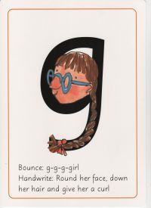
Click the pencil, watch and copy
Bounce g-g-g-girl: Round her face, down her hair and give her a curl.
g
Menu

Slide 10
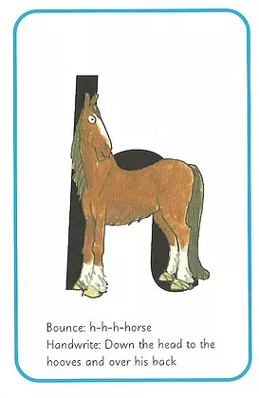
Click the pencil, watch and copy
Bounce h-h-h-horse: Down the head to the hooves and over his back.
h
Menu

Slide 11
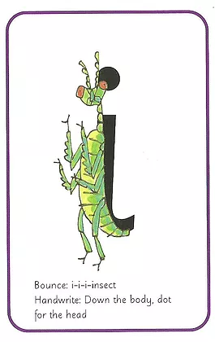
Click the pencil, watch and copy
Bounce i-i-i-insect: Down the body. Dot for the head.
i
Menu

Slide 12
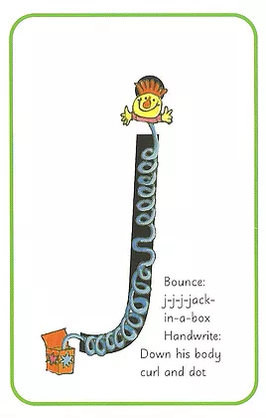
Click the pencil, watch and copy
Bounce j-j-j-jack-in-a-box: Down his body, curl and dot.
j
Menu

Slide 13
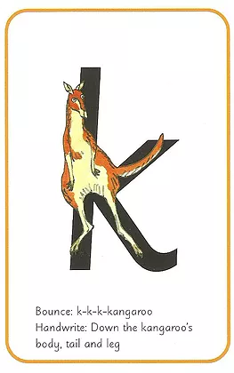
Click the pencil, watch and copy
Bounce k-k-k-kangaroo: Down the kangaroos body, tail and leg.
k
Menu

Slide 14
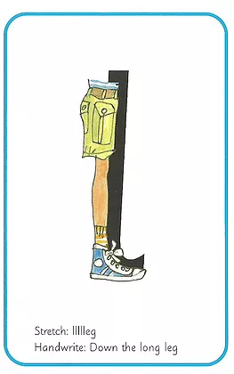
Click the pencil, watch and copy
Stretch llllleg: Down the long leg.
l
Menu

Slide 15
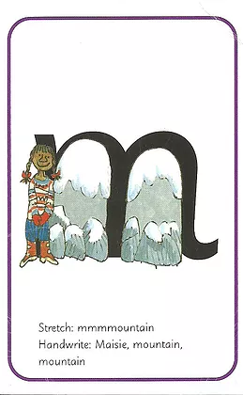
Click the pencil, watch and copy
Stretch m-m-m-mountain: Maisie, mountain, mountain!
m
Menu

Slide 16
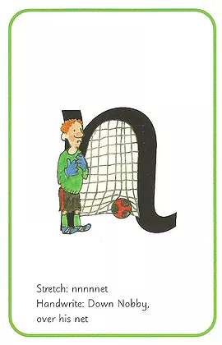
Click the pencil, watch and copy
Stretch nnnnnet: Down Nobby. Over his net.
n
Menu

Slide 17
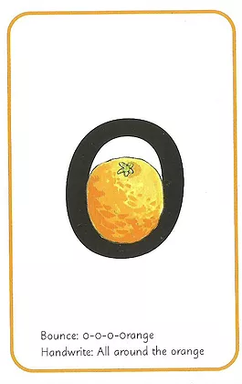
Click the pencil, watch and copy
Bounce o-o-o-orange: All around the orange.
o
Menu

Slide 18
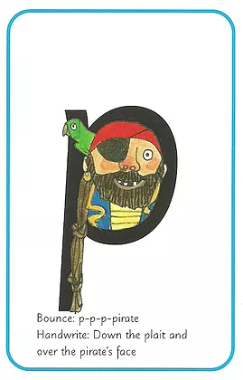
Click the pencil, watch and copy
Bounce p-p-p-pirate: Down the plait and over the pirates face.
p
Menu

Slide 19
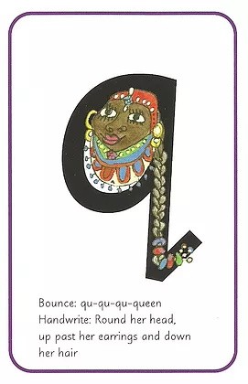
Click the pencil, watch and copy
Bounce qu-qu-qu-queen Round her head, up past her earrings and down her hair.
q
Menu

Slide 20
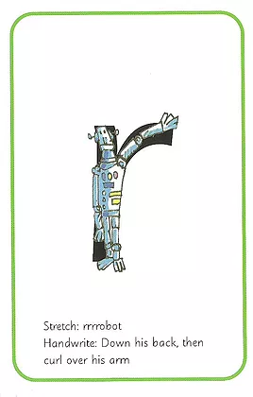
Click the pencil, watch and copy
Stretch rrrrrobot: Down his back then curl over his arm.
r
Menu

Slide 21
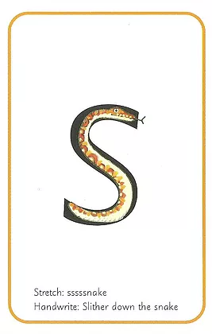
Click the pencil, watch and copy
Stretch sssssnake: Slither down the snake.
s
Menu

Slide 22
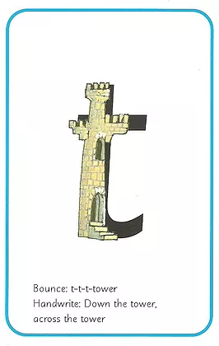
Click the pencil, watch and copy
Bounce t-t-t-tower: Down the tower, across the tower.
t
Menu

Slide 23
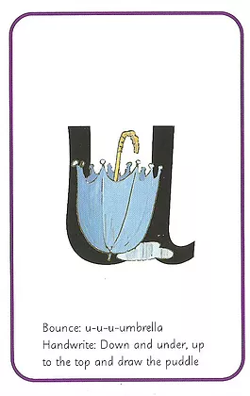
Click the pencil, watch and copy
Bounce u-u-u-umbrella: Down and under up to the top and draw the puddle.
u
Menu

Slide 24
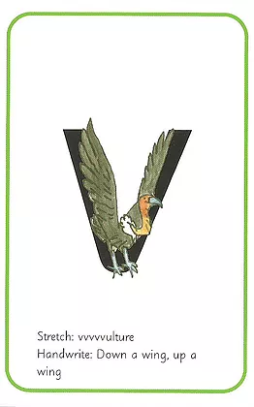
Click the pencil, watch and copy
Stretch vvvvvulture: Down a wing, up a wing.
v
Menu

Slide 25
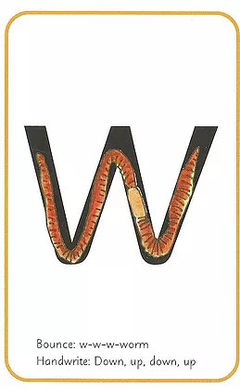
Click the pencil, watch and copy
Bounce w-w-w-worm: Down up, down up!
w
Menu

Slide 26
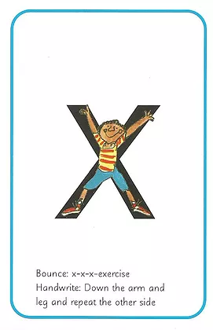
Click the pencil, watch and copy
Bounce x-x-x-x-exercise: down the arm and leg and repeat the other side.
x
Menu

Slide 27
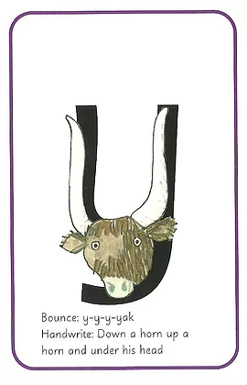
Click the pencil, watch and copy
Bounce y-y-y-yak: Down a horn, up a horn and under his head.
y
Menu

Slide 28
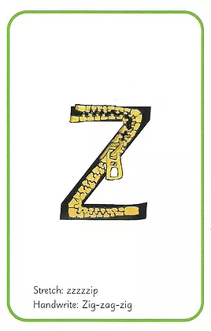
Click the pencil, watch and copy
Stretch zzzzzip: zig – zag- zig.
z
Menu

